Slide 1
Automated Program Repair via Conversation:
Fixing 162 out of 337 bugs for $0.42 each using ChatGPT
University of Illinois at Urbana-Champaign (UIUC), USA
Presenter: Thi Van Anh Dau

Slide 2
Motivation
APR: automatically generate patches for bugs in software
Limitations of existing approaches:
Traditional APR tools: lack of patch variety
Learning-based APR:
rely heavily on the training data
may not generalize to unseen bugs

Slide 3
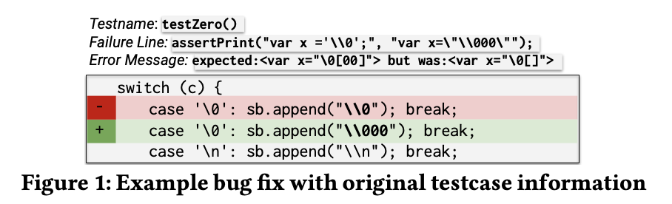
Motivation
Limitations of existing approaches:
Recent advanced LLMs for APR:
Missing test failure information
Repeated sampling
Ignorance of valuable plausible patches

Slide 4
Contribution
ChatRepair, a conversation-driven APR tool using the ChatGPT model
They leverage previously ignored test failure information and test success in a conversion manner
ChatRepair obtains the new state-of-the-art repair result on Defects, QuixBugs and ConDefect datasets with high performance and low cost

Slide 5
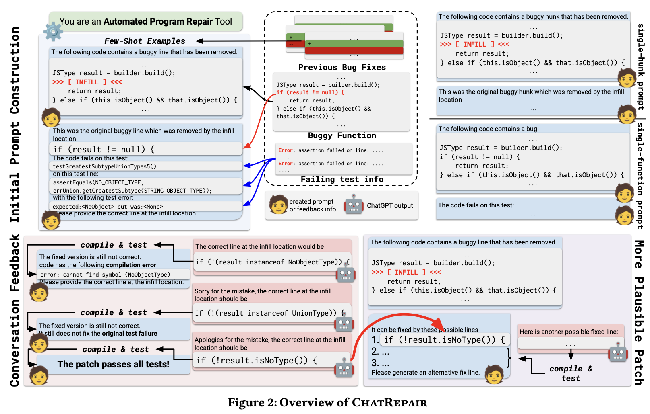
Overview

Slide 6
Initial Input
the buggy code within
the function with an
infill location indicator
buggy line
failing tests
its name
failure code line
error message

Slide 7
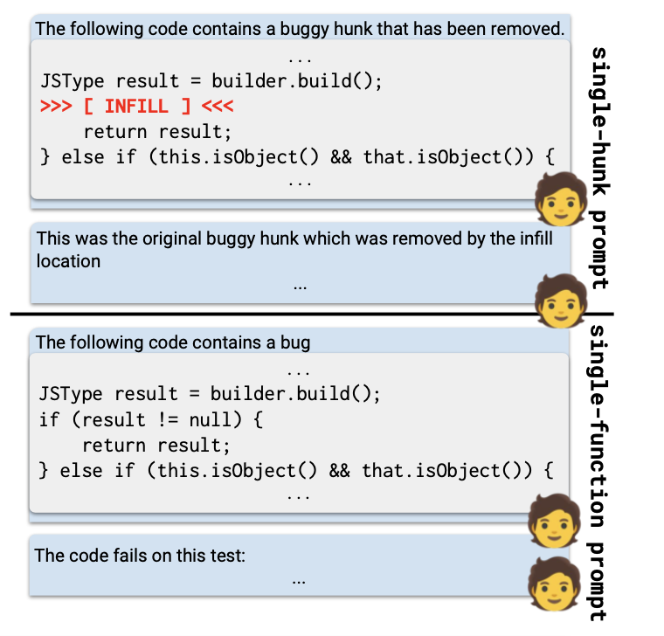
Initial Input
repair strategy
single-line
single-hunk
single-function

Slide 8
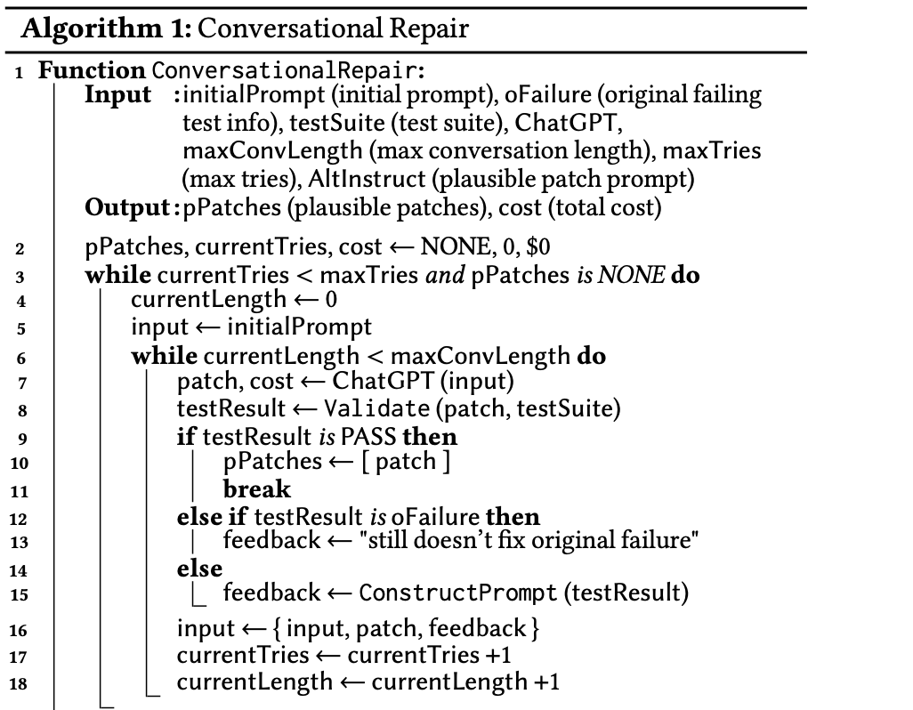
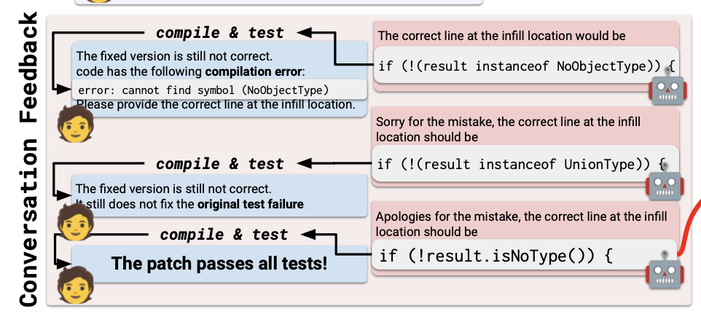
Conversational Repair

Slide 9
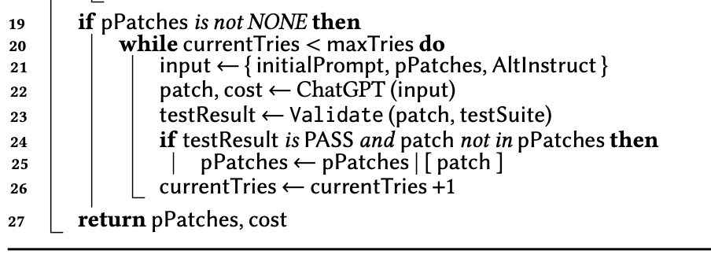
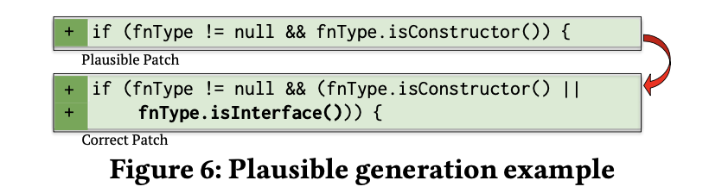
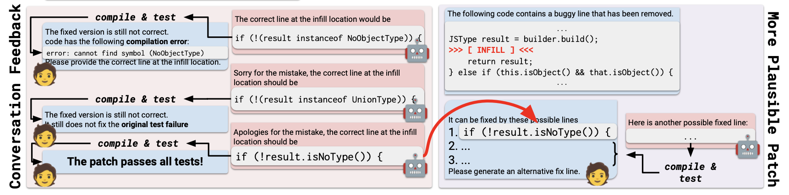
Plausible Patch Generation

Slide 10
Experiment Setup
Repair scenarios
single-line–fixed by replacing/adding a single line
single-hunk–fixed by replacing/adding a continuous code hunk
single-function–fixed by generating a new function to replace the original buggy version

Slide 11
Experiment Setup
Temperature = 1
Maximum conversation length = 3
Maximum number of repair attempts
200 for single-line and single-hunk
100 for single-function

Slide 12
Benchmarks
2 popular repair benchmarks: Defect4j, QuixBug
ConDefect: single-line programming contest bugs collected after October 2021

Slide 13
Baseline
10 learning-based and LLM-based technique: FitRepair, SelfAPR, AlphaRepair , RewardRepair, Recoder, CURE, CoCoNuT, DLFix, SequenceR, CodexRepair, BaseChatGPT
12 traditional APR tools: TBar, PraPR, AVATAR, SimFix, FixMiner, CapGen, JAID, SketchFix, NOPOL, jGenProg, jMutRepair, and jKali

Slide 14
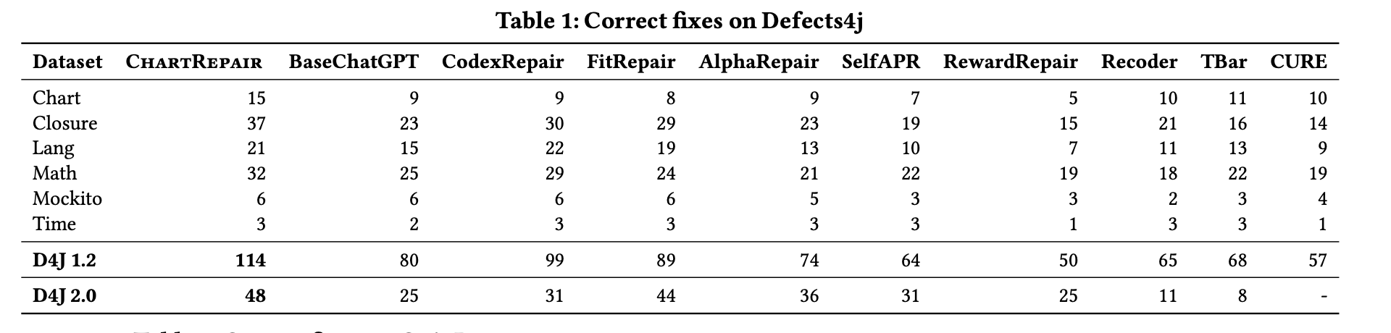
RQ1: Effectiveness of ChatRepair compared to other baselines

Slide 15
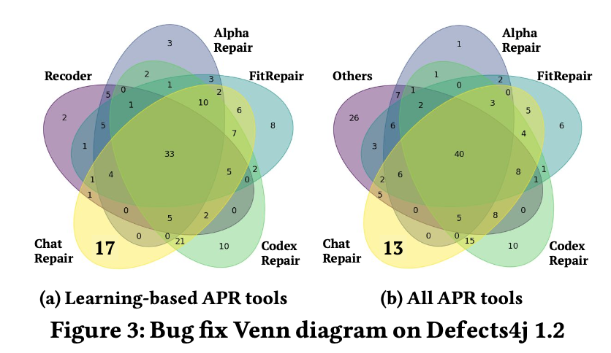
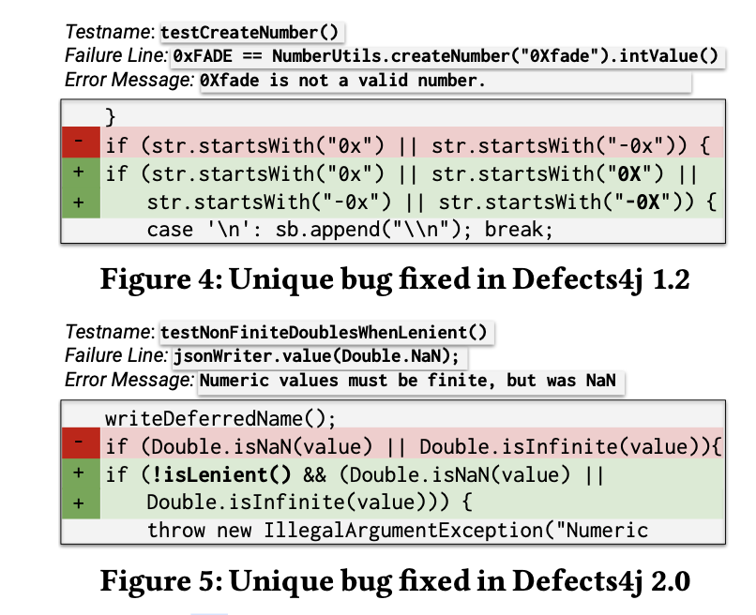
RQ1: Effectiveness of ChatRepair compared to other baselines

Slide 16
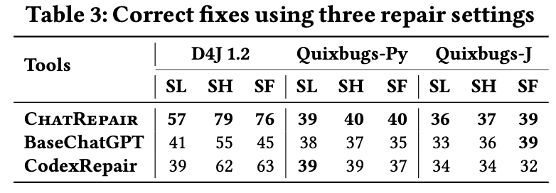
RQ2: Repair Scenarios

Slide 17
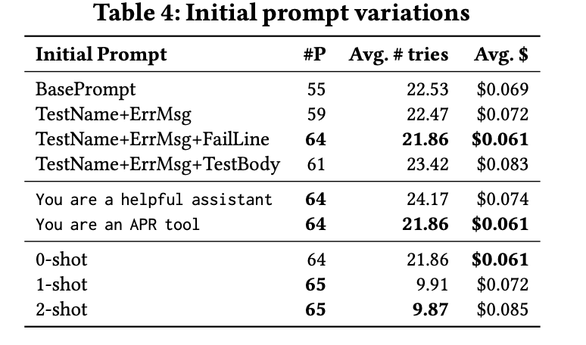
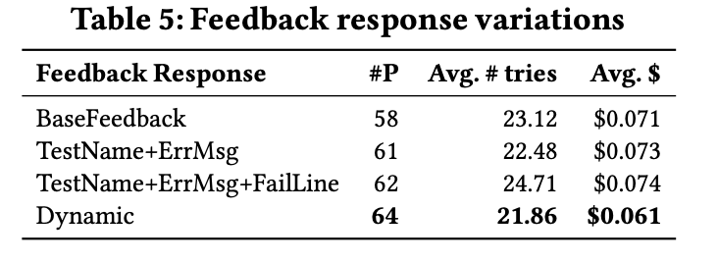
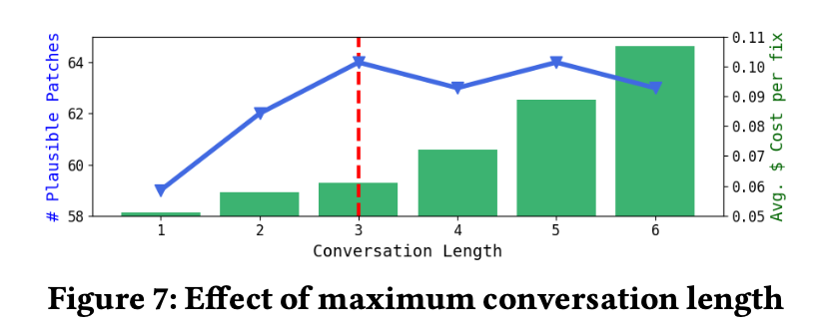
RQ3: Ablation study

Slide 18
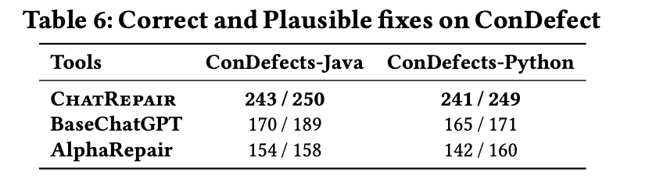
RQ4: Evaluation on the recent bugs

Slide 19
Limitation
ChatRepair depends heavily on test suite
Lack of evaluation on the open-source models
Scalability Concerns
Limited Exploration of Multi-Hunk Bugs

Slide 20
Future Work
improve ChatRepair with LLM-based agents
identify potential buggy locations
obtain useful repair-specific information
explore multi-hunk repair

